Slide 1
Team A Ken Berger, Jim Kurtz, Mark Lavine, Michael Schneider
Q4 CAR Champion Calibration
2015

Slide 2
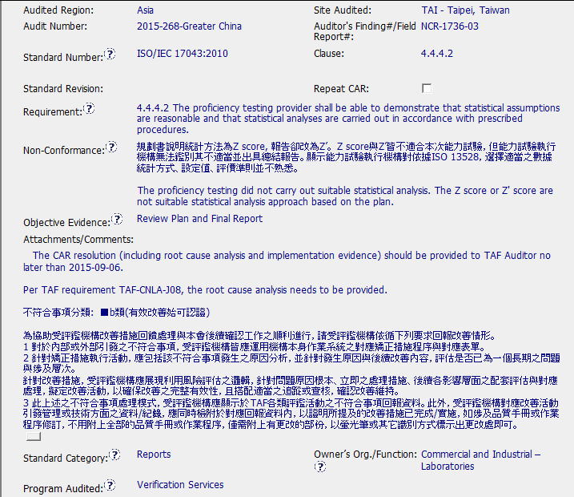
CAR# 153914933– Finding
Non-conformance not clear, z score is acceptable per IEC 17043

Slide 3
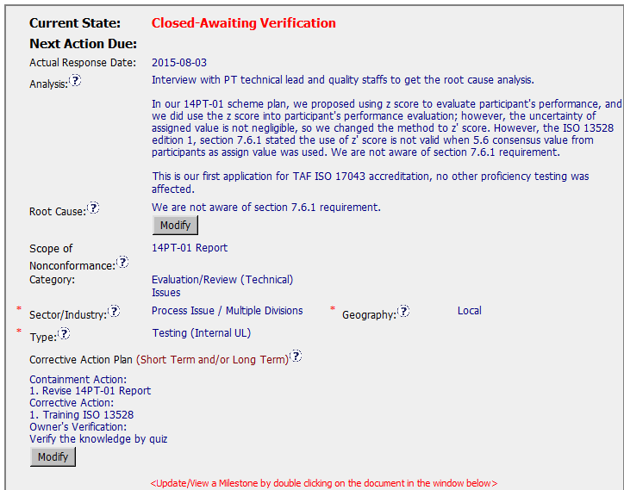
CAR# 153914933– Finding, RCA
Changing the methodology to “fix” the results may have contributed
Second standard is being referenced, not sure why?
Weak root cause

Slide 4
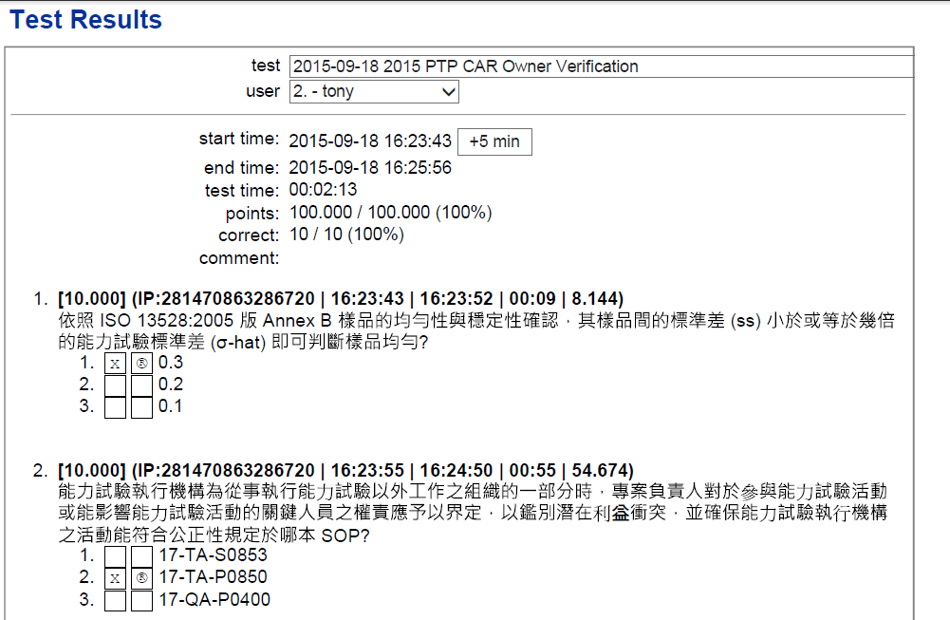
CAR# 153914933– Finding, Milestone evidence
all participants scored 100%
Test is in Chinese – English is required.

Slide 5
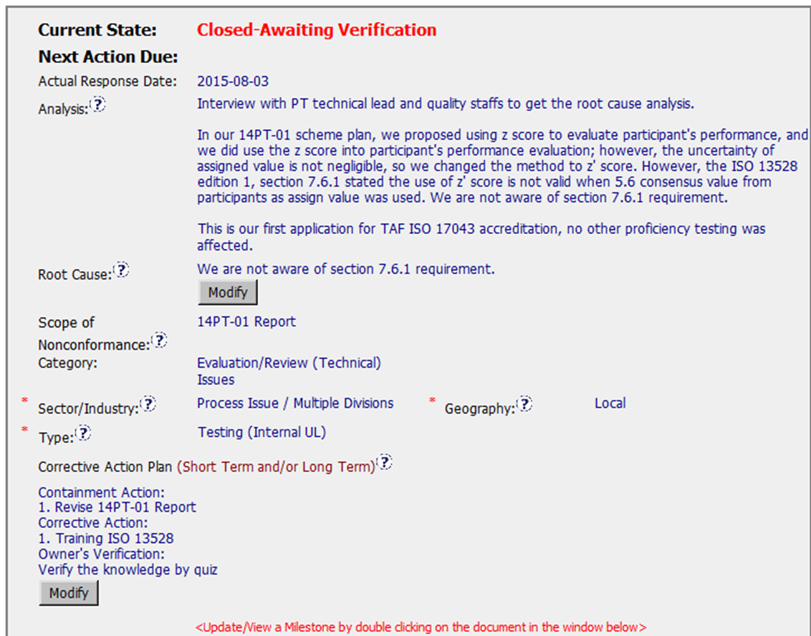
CAR# 153914933– Finding
Still waiting on verification.

Slide 6
CAR# 153914933– Finding
CBS Requirements | Excellent | Moderate | Need Improve | N/A
INTEGRITY
(C) Extensions are within requirement (<30 days, 3 or less) | x
(T) Most appropriate ‘category’, ‘type’, ‘geography’ are selected | x
(P) Facilitates the handling of disputed CARs |  |  |  | x
(T) Acts on CARs within required timeframe |  | x
COMPETITIVENESS
(C) Analysis shows clear path to root cause and scope; stakeholders identified |  |  | x
(C) Root cause statement is succinct, reasonable, complete (Shows ‘N/A’ for observations) |  |  | x
(C) Corrective actions fix the objective evidence and other problems found; address entire root cause and scope. For observations, they do not go beyond fixing the objective evidence |  | x
(C) Milestones address containment & owner’s verification; completed per milestone expectations | x
(P) Verification per requirements |  |  | x
COLLABORATION
(L Referenced communications are attached as needed | x
(C L) Evidence of communication for overdue/escalated CARs and other pertinent concerns |  |  |  | x
(P) Trains other CAR Champions |  |  |  | x

Slide 7
THANK YOU

Slide 8
Team B: Jeffery Lietz, Bruce Eng, Tovia Bat-Leah, Dale Hendricks; CARs 153914933, 153915322, 153915273 + one “exemplary”.

Slide 9
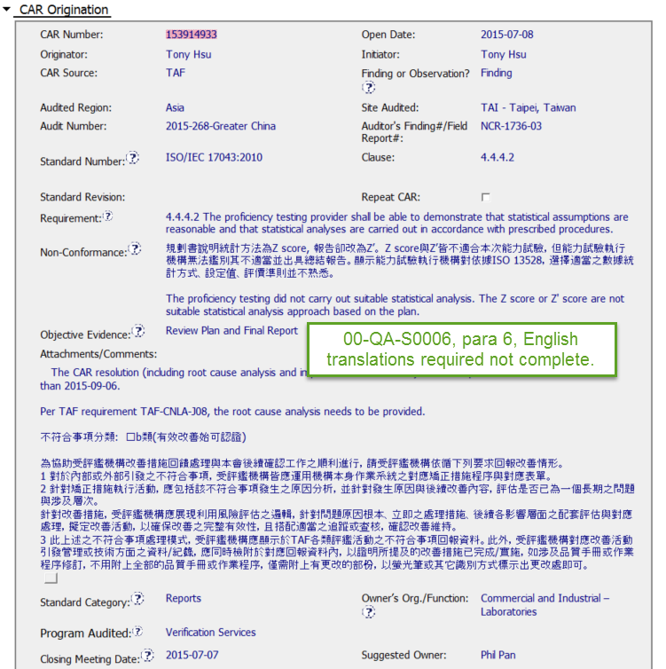
CAR 153914933

Slide 10
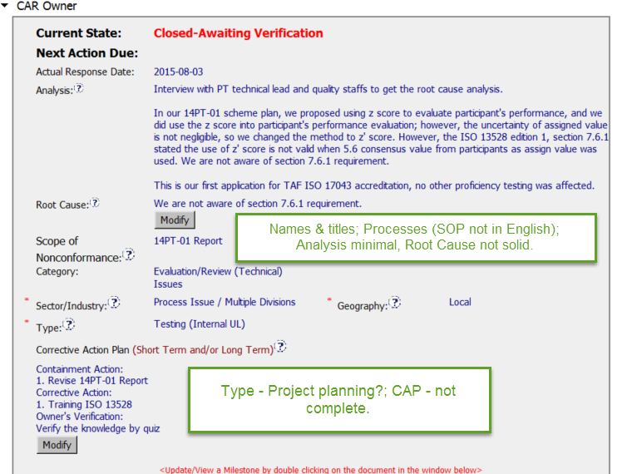
CAR 153914933

Slide 11
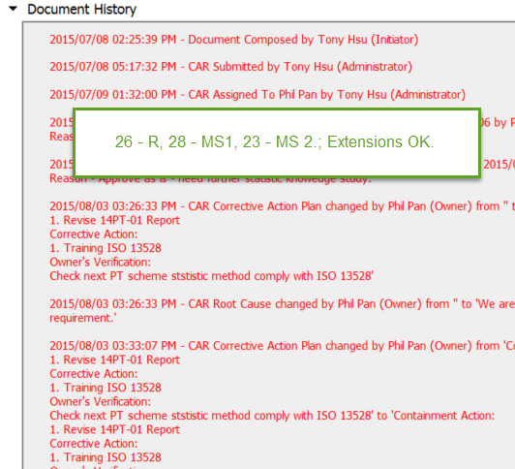
CAR 153914933

Slide 12
CAR 153914933
CBS Requirements | Excellent | Moderate | Need Improve | N/A
INTEGRITY
(C) Extensions are within requirement (<30 days, 3 or less) | x
(T) Most appropriate ‘category’, ‘type’, ‘geography’ are selected |  |  | x
(P) Facilitates the handling of disputed CARs |  |  |  | x
(T) Acts on CARs within required timeframe |  | x
COMPETITIVENESS
(C) Analysis shows clear path to root cause and scope; stakeholders identified |  |  | x
(C) Root cause statement is succinct, reasonable, complete (Shows ‘N/A’ for observations) |  |  | x
(C) Corrective actions fix the objective evidence and other problems found; address entire root cause and scope. For observations, they do not go beyond fixing the objective evidence |  | x
(C) Milestones address containment & owner’s verification; completed per milestone expectations | x
(P) Verification per requirements |  |  |  | x
COLLABORATION
(L Referenced communications are attached as needed |  | x
(C L) Evidence of communication for overdue/escalated CARs and other pertinent concerns |  |  |  | x
(P) Trains other CAR Champions |  |  |  | x

